Slide 1
Programming 4
12.1 Functional Programming 1
Semester 2, 2019

Slide 2
Functional programming principles
Functions are first class objects
Programs are stateless
High-order functions:
Map
Filter
Reduce
Partials/Closures
Lambda
No looping

Slide 3
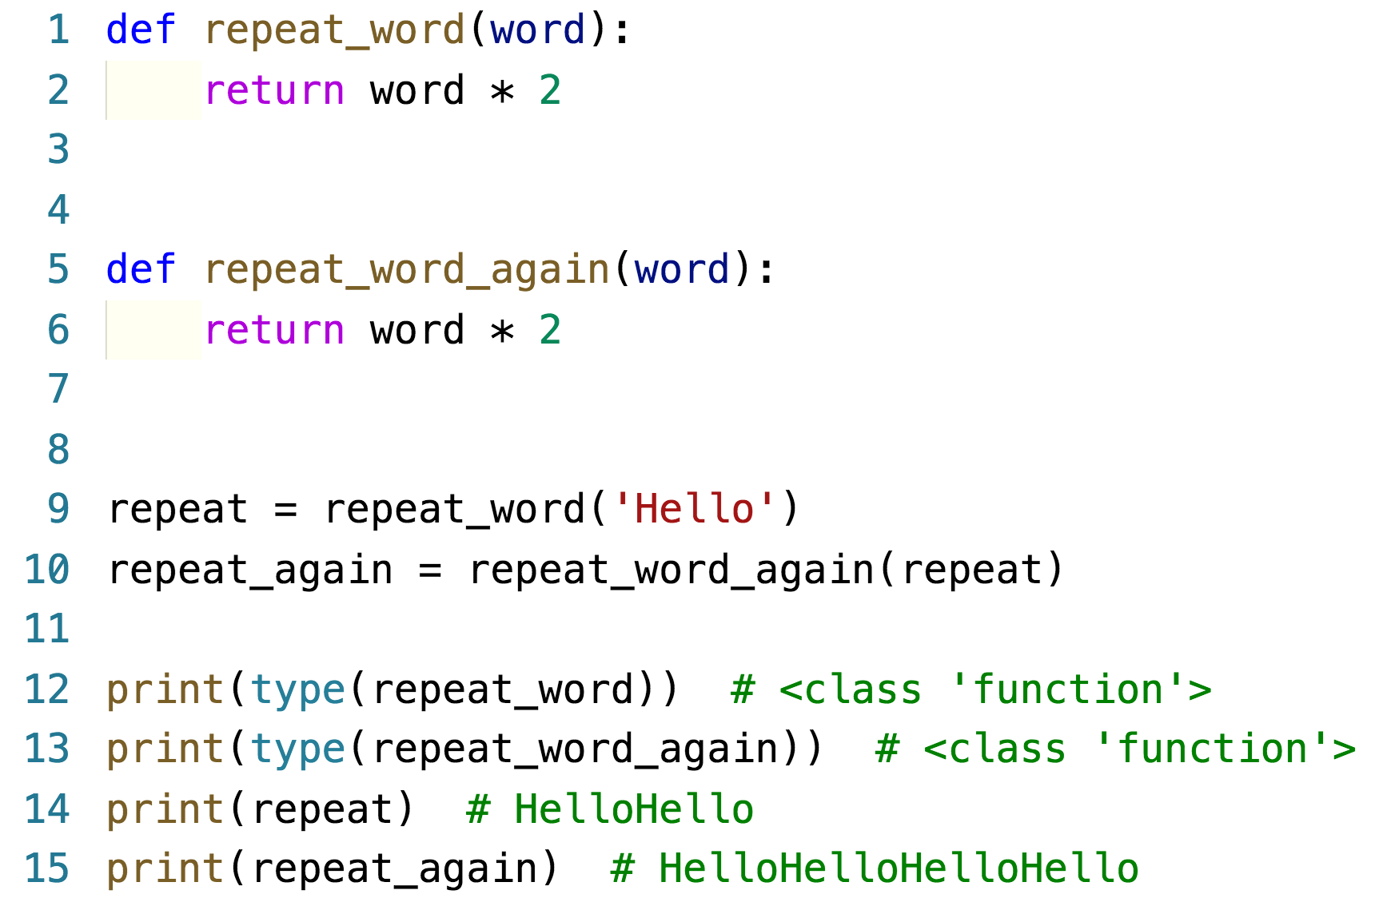
Functions as objects
Treat a piece of code like a piece of data
Assign to a variable
Pass to and return from another function

Slide 4
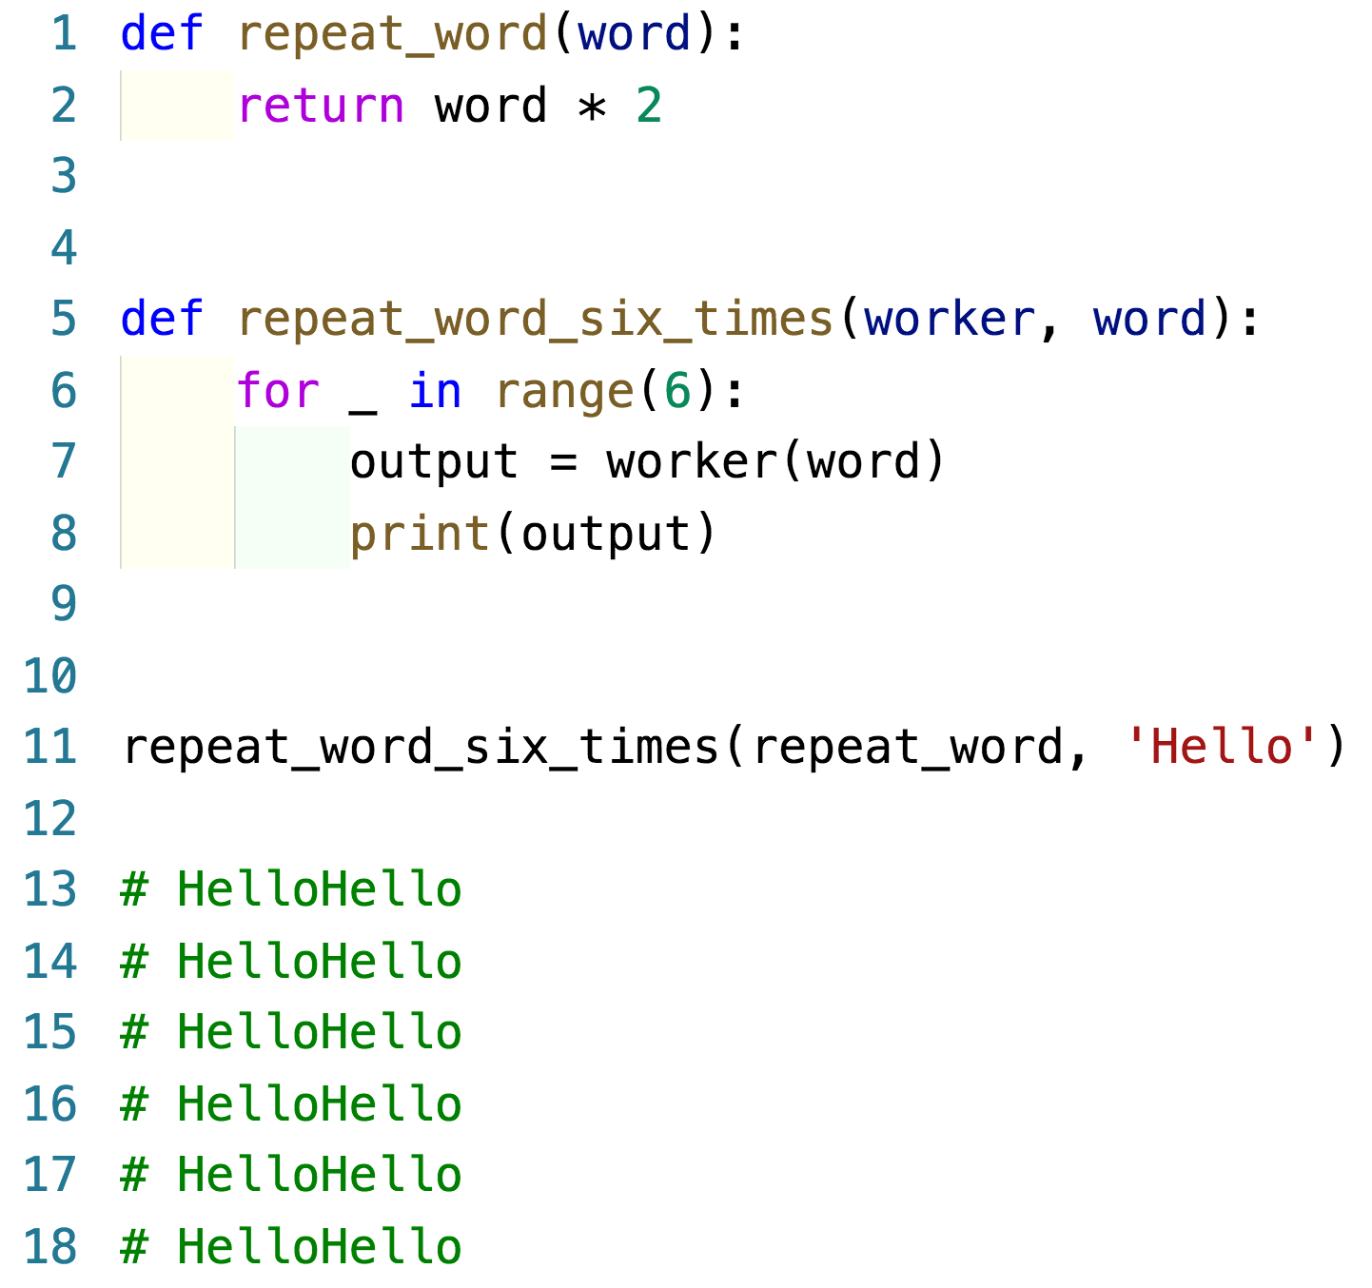
Example – functions

Slide 5
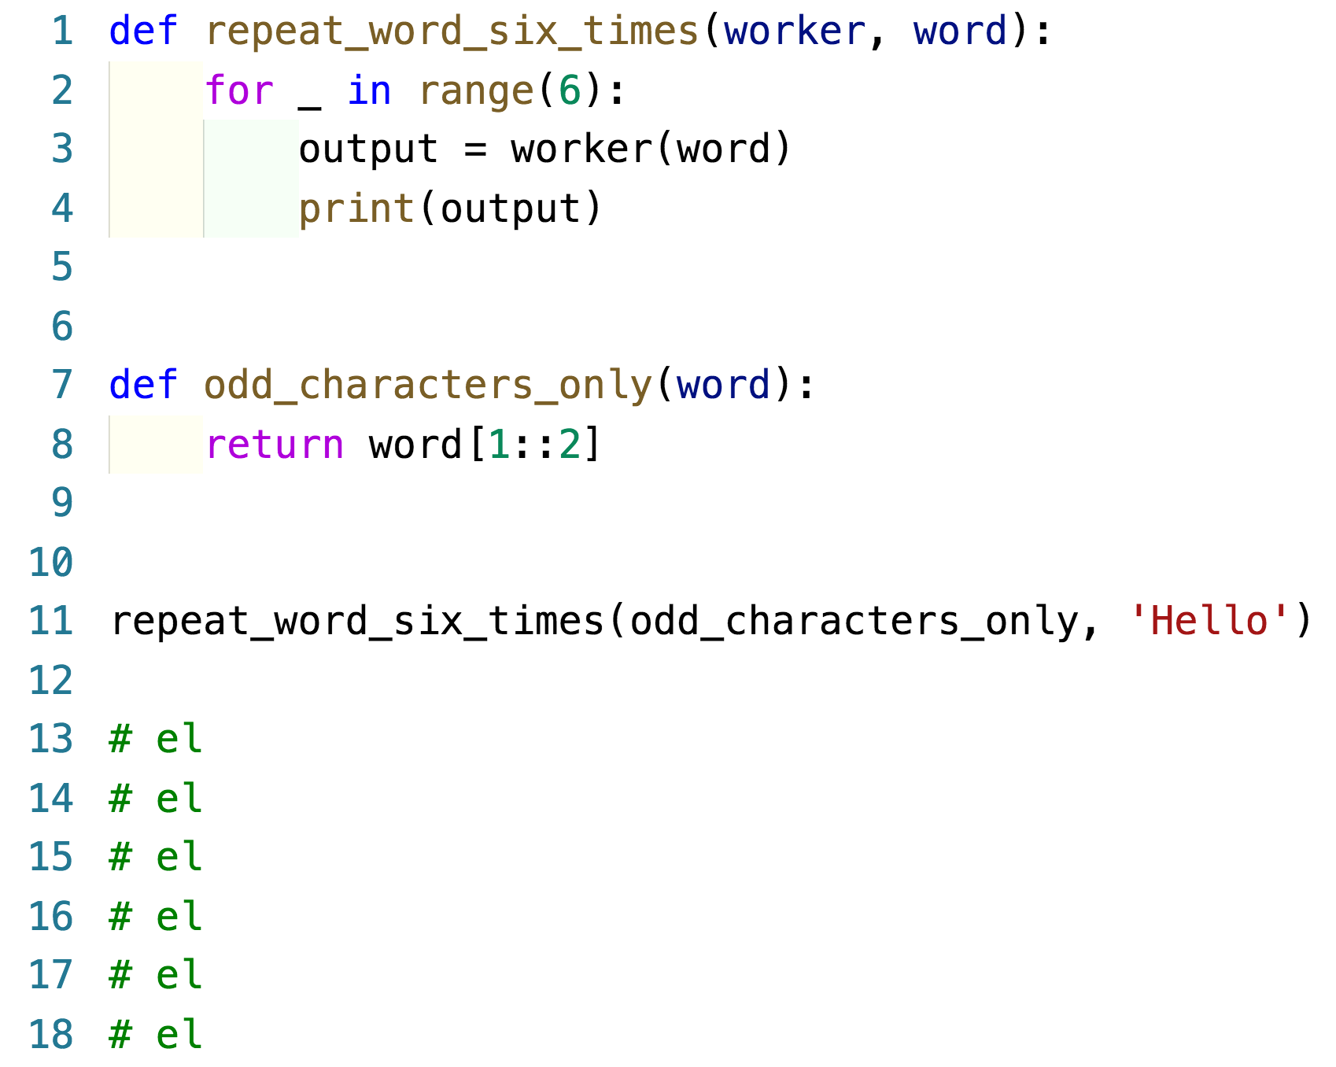
Functions as objects
Passing different worker functions
“Passing functions as arguments” works in complex scenarios

Slide 6
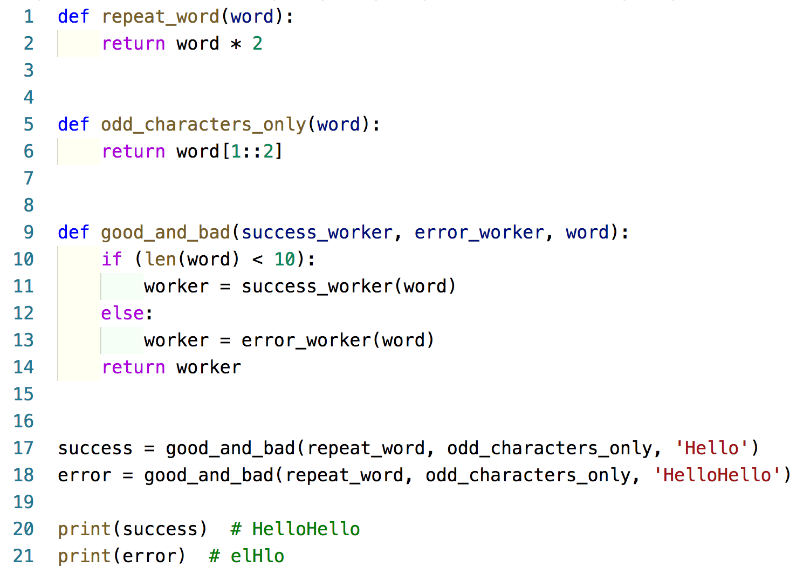
Functions as objects
Callbacks
Event-driven

Slide 7
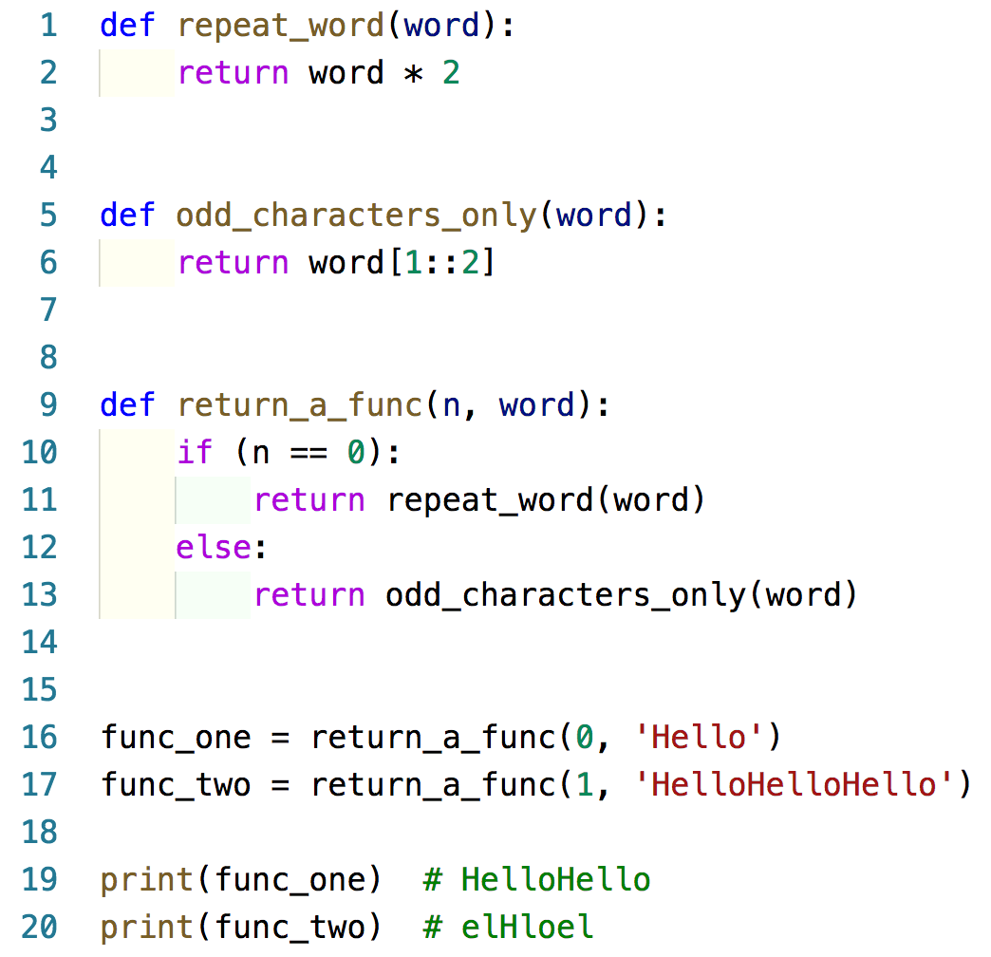
Functions as objects
Function returns
Fully dynamic

Slide 8
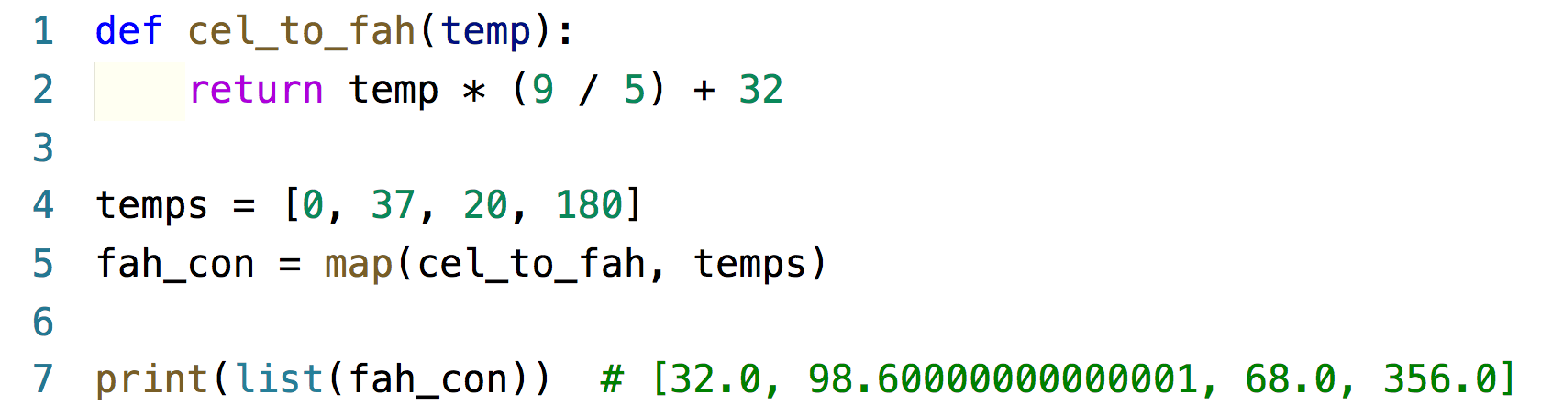
Higher-order functions – map
Takes a worker function and a sequence
Built-in function that accepts a function operator
An alternative to traditional for loops

Slide 9
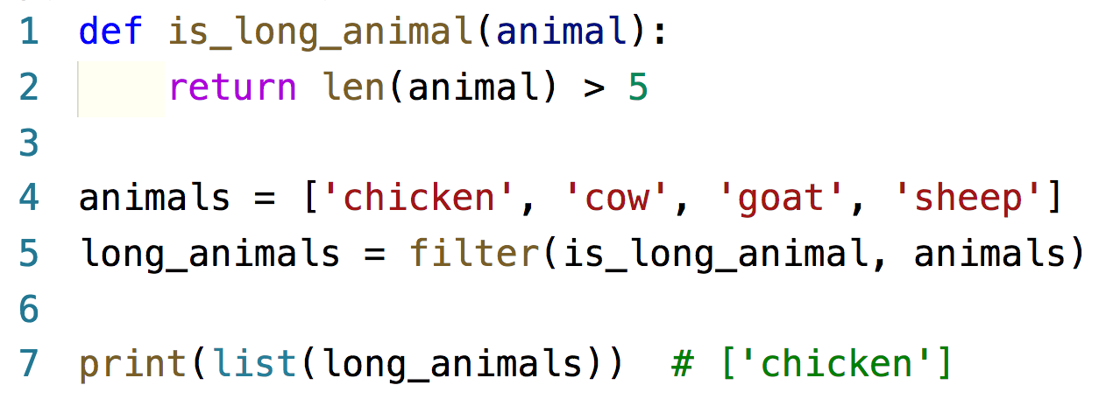
Higher-order functions – filter
Takes a predicate function and a sequence
Predicate function – accepts one argument and
returns a boolean

Slide 10
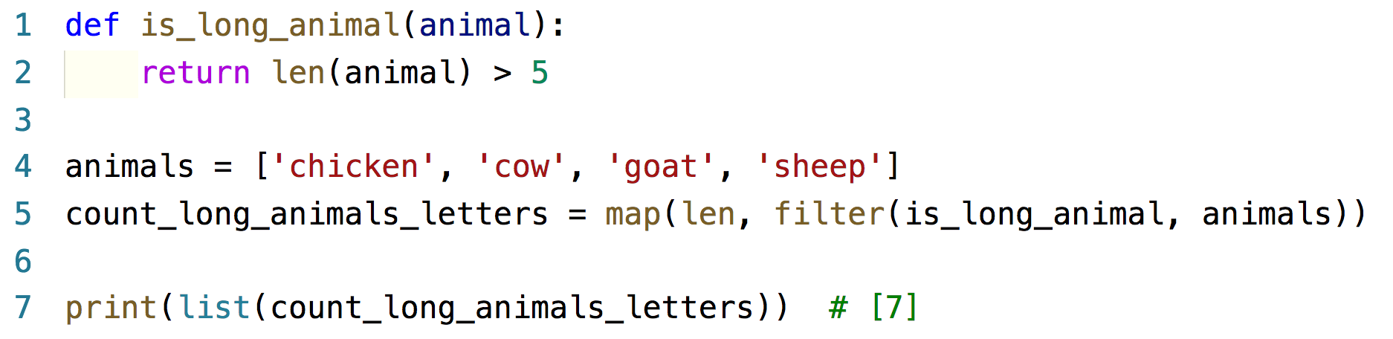
Example – map and filter

Slide 11
Higher-order functions – reduce
Takes a function and a sequence
Function is applied to items one and two of the sequence
Function is then applied to the result of that step
and item three…so on
At the end, only one value remains

Slide 12
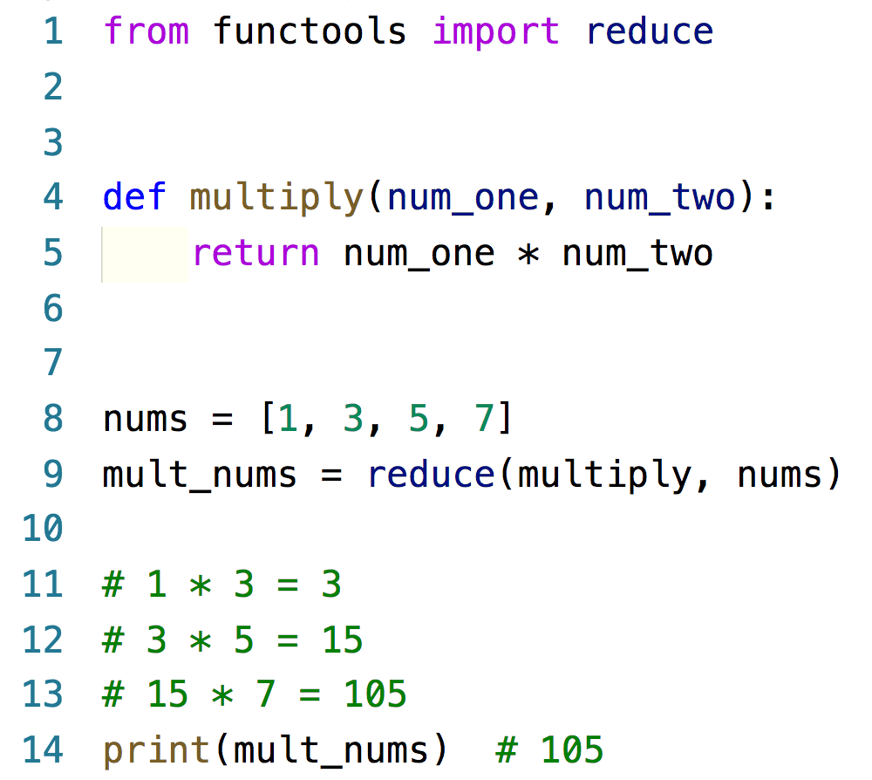
Example – reduce

Slide 13
Partials/closures
Keep alive a variable even when the function
has returned
Call a function without supplying all the
arguments it requires
Nesting a function inside the encapsulating function
Return the underlying function

Slide 14
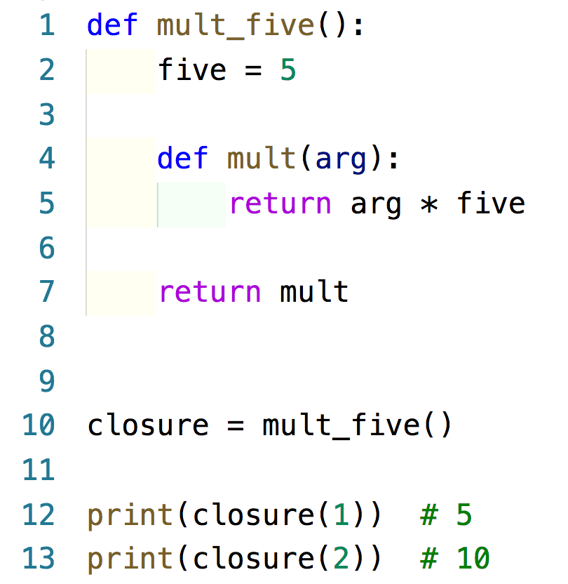
Example – partials/closures

Slide 15
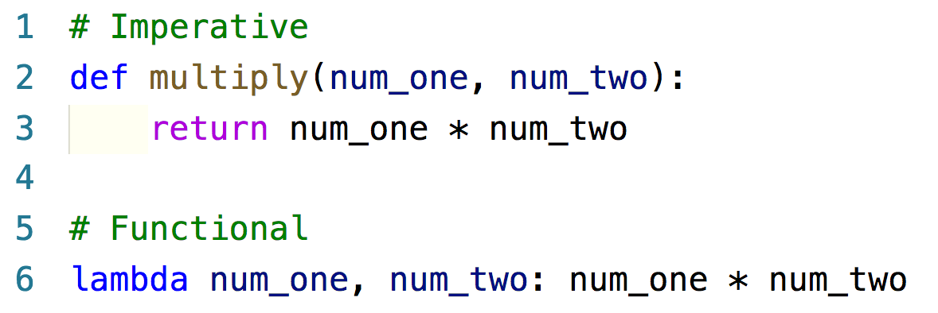
Lambda
Functions are defined anonymously
Lambda syntax – lambda calculus
Lambda sequence – variables: function code (with implicit return)
No def keyword

Slide 16
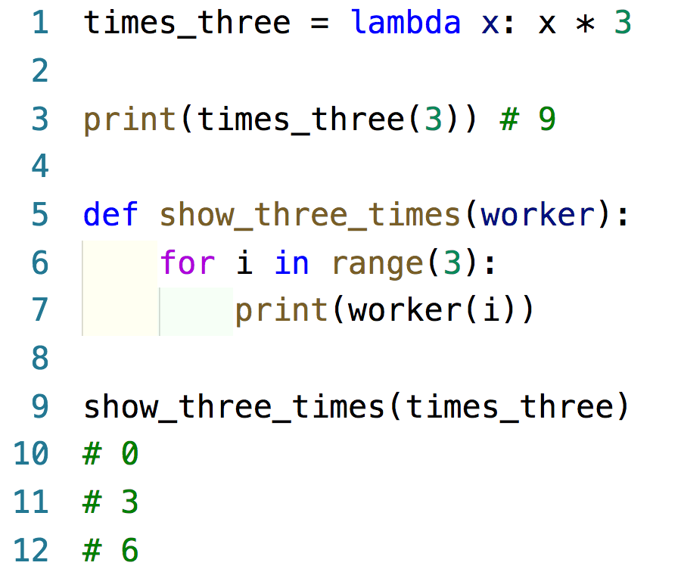
Lambda
Lambda assignment
Function passing
Can be used with other higher-order functions
Do you see any downsides?

Slide 17
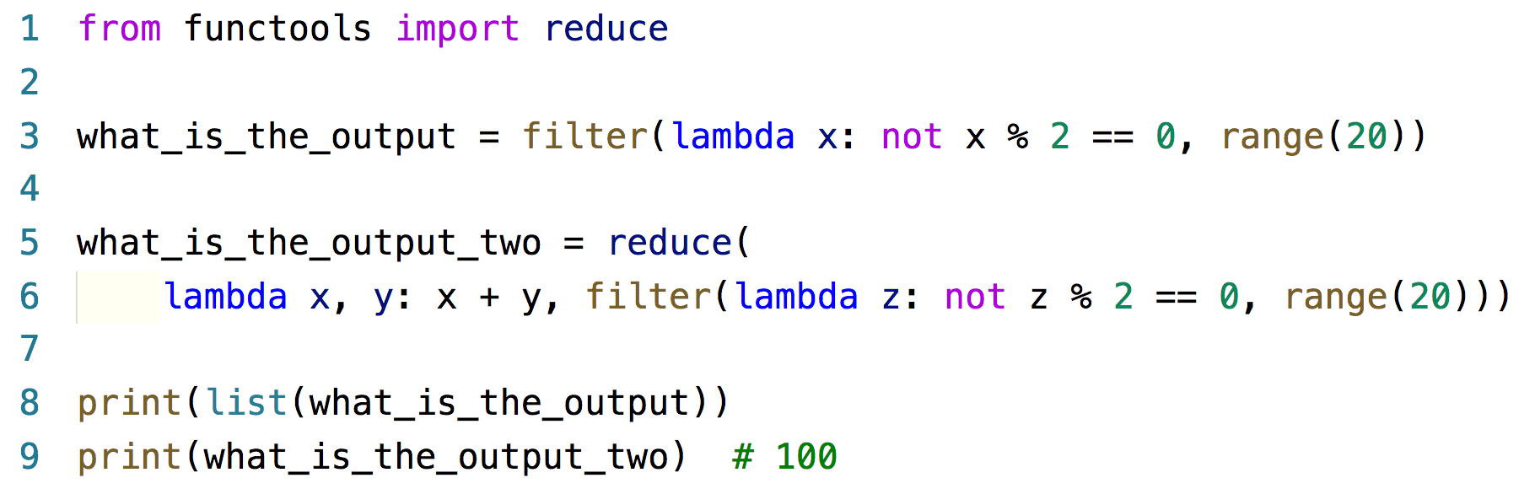
Example - lambda

Slide 18
FP is not idiomatic
FP revolves around lists
Other than reduce and partials/closures, all
functions generate lists
Guido van Rossum dislikes FP

